Slide 1
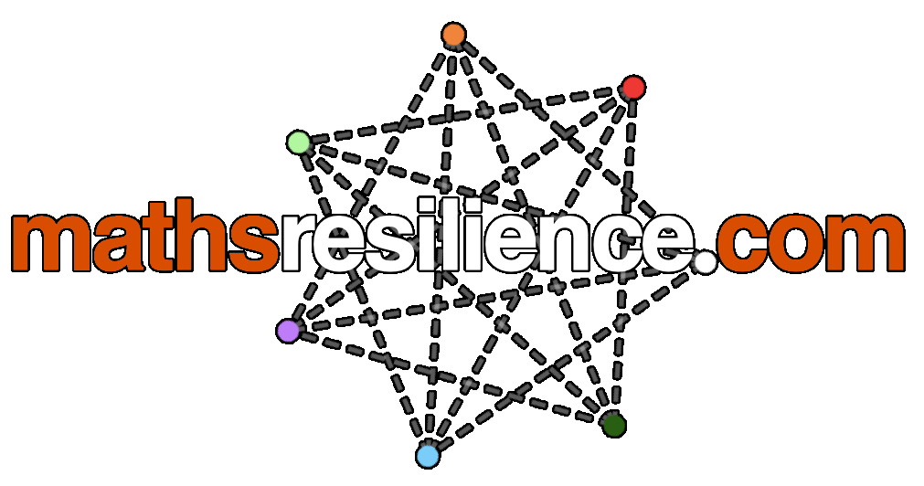
What is Mathematical Resilience?
A guide for students.

Slide 2
What is resilience in maths?
Resilience in mathematics shows a willingness to try to solve problems that are unknown to an individual – much like the problems or jobs that may exist in the future that we do not know of yet. It looks at your responses to questions like these:
Do you feel confident or nervous when doing maths?
What do you do when you get stuck on a maths problem?
Do you see think maths is a useful subject to study?
How does how your friends and family think about maths affect you?

Slide 3
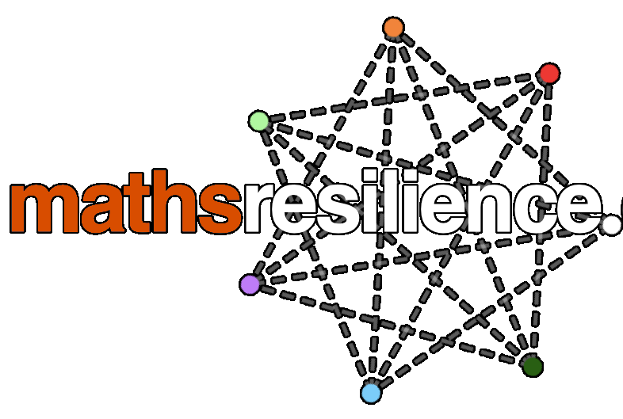
The seven characteristics of resilience
There are seven areas of mathematical resilience, that work together to form your overall attitude towards mathematics.
Notes:
Throughout the day, I have seen mention of some of these seven areas in isolation – here I will bring them all together to look at an overall picture of what a student experiences when they do mathematics, and how each of them fit together to form the idea of mathematical resilience.

Slide 4
Self Concept
Self Concept
This area looks at how confident you are in your own mathematical abilities.
Notes:
An individual would have a high Self-Concept in mathematics if they believe that they are good at solving a variety of different problems in mathematics - however it is more difficult to determine whether pupils who like mathematics are better at it, or that pupils who are better at mathematics like it more.

Slide 5
Maths Anxiety
Maths Anxiety
This area looks at whether you feel anxious or stressed when asked to do maths.
Notes:
A mathematically resilient person would not experience these feelings and will have a growth mindset when answering mathematics problems.
Mathematical Anxiety is defined as "a feeling of tension, apprehension, or fear that interferes with maths performance”, and some individuals who suffer from mathematical anxiety can even suffer a physical reaction to mathematics similar to that of pain. As such, students who report having mathematical anxiety tend to underperform in mathematics activities as they are either concentrating on being worried about the task itself or are completely avoiding the activity as a natural reaction to avoid pain.
Many students worry about their performance in school and do feel anxious before taking an exam, however large proportions of students admit to being particularly anxious about mathematics.
It is important to remind students that everyone learns maths at a different pace – students tend to forget this and try to keep up with their peers, which can lead to anxiety if they feel that they are falling behind.

Slide 6
Mathematical Dispositions
This area looks at how those who are close to you feel towards mathematics, for example your parents or friends.
Mathematical Dispositions
Notes:
A mathematically resilient person would have a good support structure in place at home and at school to help foster a liking for mathematics from an early age.
Negative perceptions of mathematics can also be inherited by students from their parents who themselves had bad experiences of learning mathematics whilst at school. Whilst parents may have had a bad experience of mathematics, they may still believe that it is important to do well in.
It also appears that being negative about mathematics is culturally accepted in the UK in a way that is not accepted of other subjects. This is seen regularly on TV quiz shows and TV programmes, being good at maths is often looked down upon, leading students to believe that maths is ‘uncool’, and that it doesn’t matter if they do badly in it.

Slide 7
Problem Solving & Perseverance
This area looks at whether you have confidence in continuing a problem that may appear difficult, as well as being open towards mathematical problems to which you may not know the method or solution.
Problem Solving & Perseverance
Notes:
A mathematically resilient person would have a high perseverance level, particularly when it comes to open-ended problems, or ones that appear difficult at first. All pupils, even the most able, should expect to struggle and should welcome the challenge. Some students do find more open ended and unusual problems daunting; being stuck is viewed negatively rather than as a challenge to be overcome.

Slide 8
Locus of Control
This area looks at whether you attribute success or failure in mathematics to yourself or to some external influence.
Locus of Control
Notes:
This term comes from psychology and was developed by Julian B Rotter in the 1950s.
A more mathematically resilient person would give themselves the credit when they have achieved in mathematics, and also take the responsibility on themselves rather than looking elsewhere for blame when they do not succeed.
“I’m just not good at maths” or “I’ve never been good at maths”
“My teacher isn’t very good - so that’s why I’m bad at maths”
This is also split into success and failure – some students may be more willing to blame others if things go wrong.

Slide 9
Motivation
This looks at both whether you do maths for the enjoyment of the subject and whether you believe in the usefulness of maths as reasons why you do maths.
Motivation
Notes:
A mathematically resilient person would have a high motivation for wanting to succeed in mathematics, whether for their own enjoyment or future goals.
Employers say that it is important that people have studied mathematics at a higher level than they will actually use, which will enable them to be more confident and versatile when faced with unfamiliar situations or problems.
Students need to be motivated to do well in maths - so to improve motivation in some students, it may be necessary to ensure that students achieve small successes to help improve motivation.

Slide 10
Conscientiousness
This area measures how much you care about your own learning in maths lessons as well as homework, and whether you talk about maths with your friends.
Conscientious-ness
Notes:
A mathematically resilient person would be able to show it in their mathematics work, as well as having the confidence to help others with problems when asked. Students showing high levels of engagement in their mathematical studies typically perform higher, and high achievers, again, have a strong self-concept and positive attitude.

Slide 11
The seven characteristics of resilience
Self Concept
Maths Anxiety
Having an awareness of your levels in each of these seven areas can help you to improve in your maths learning.
Conscientious-ness
Mathematical Dispositions
Motivation
Problem Solving & Perseverance
Locus of Control

Slide 12
Sign up to the website
Use the link sent to you by your teacher to register for the site.
The link should look something like this:
www.mathsresilience.com/classes/CLASSCODE
This code is unique for every class set up on the site – make sure you join the correct one!

Slide 13
The questionnaire
Once registered, complete the questionnaire on the questionnaire tab.

Slide 14
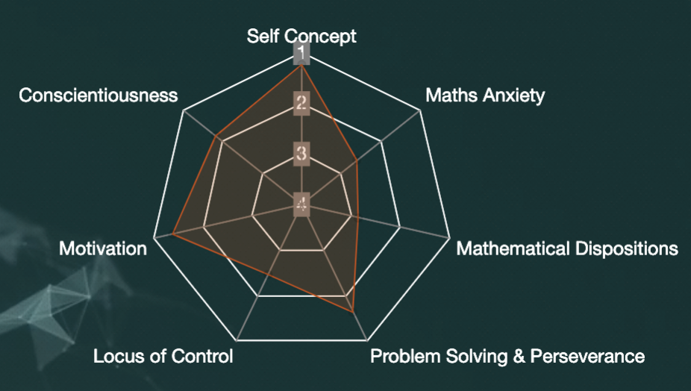
Your Result
Your result will give you a score in each of the seven areas of mathematical resilience, along with what your score means and some advice on what to do to improve.
You can view your results and advice at any time by logging in and choosing the “My Results” option in the user dropdown menu.

Slide 15
Repeating the questionnaire
You can retake the questionnaire whenever you wish to, not just under the direction of your teacher.
Your mathematical resilience is not static, it changes all the time. You should repeat the questionnaire at least three times a year to keep track of your results, and to see any changes in your mathematical resilience.

